Slide 1
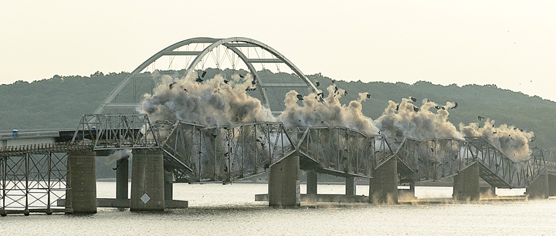
Large-Diameter Pipe Pile Installation
at Kentucky Lake
47th Annual STGEC
Biloxi, Mississippi – November 7-10, 2016
Presented by:
Darrin Beckett – KYTC
Ron Ebelhar – Terracon Consultants

Slide 2
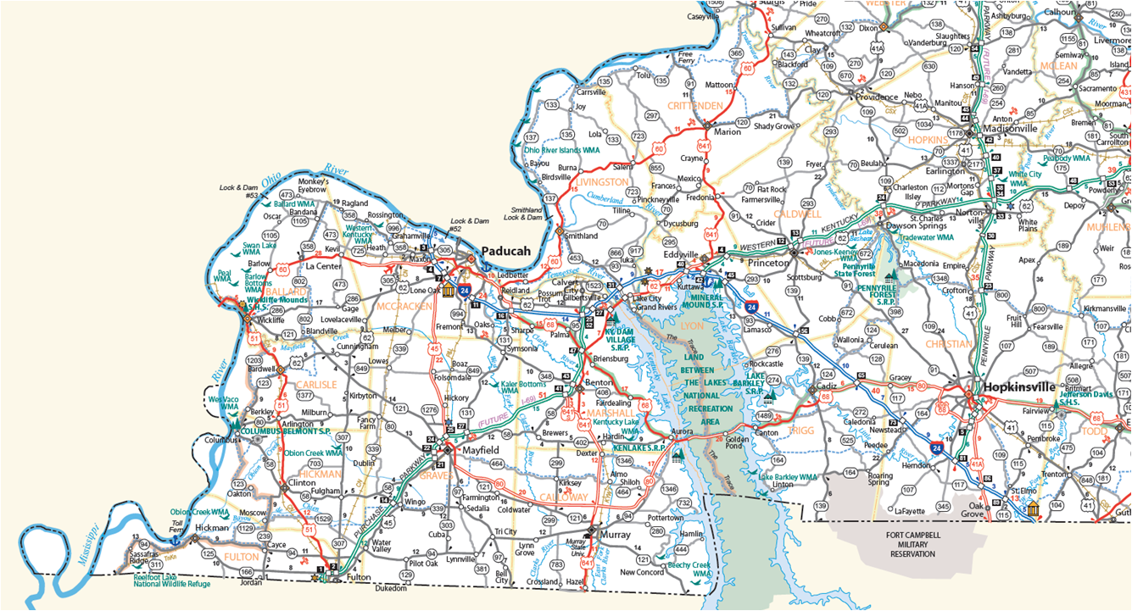
Project Site
Kentucky Official Highway Map

Slide 3
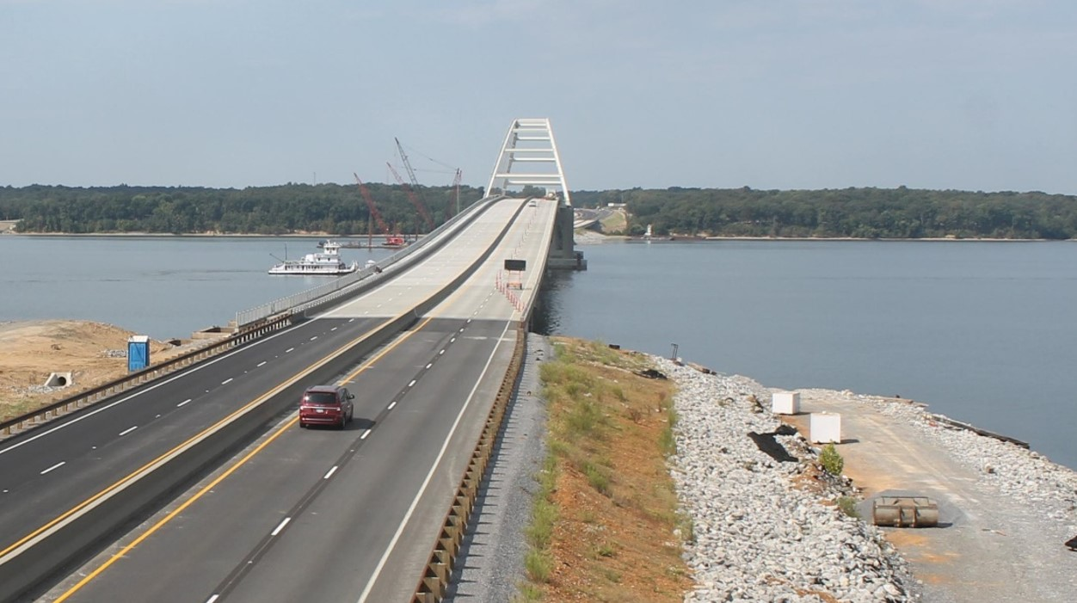
As-Built Bridge
www.lakebridges.com

Slide 4
Presentation Scope
1. Subsurface Conditions
2. Pier Foundation Design Considerations
3. Load Test Program
4. Production Pile Installation
5. Setup Magnitude & Rate
6. Constrictor Plate Considerations
7. Superposition Concept

Slide 5
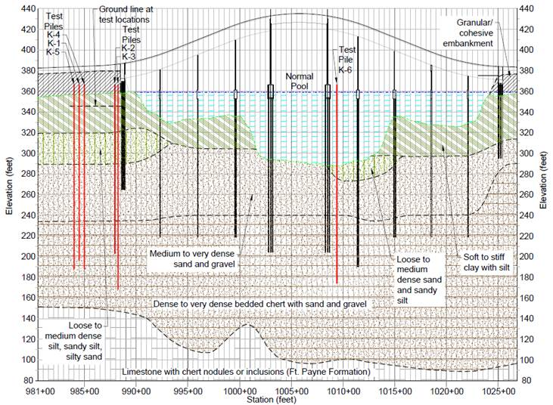
1. Subsurface Conditions

Slide 6
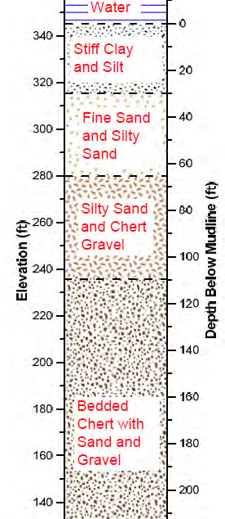
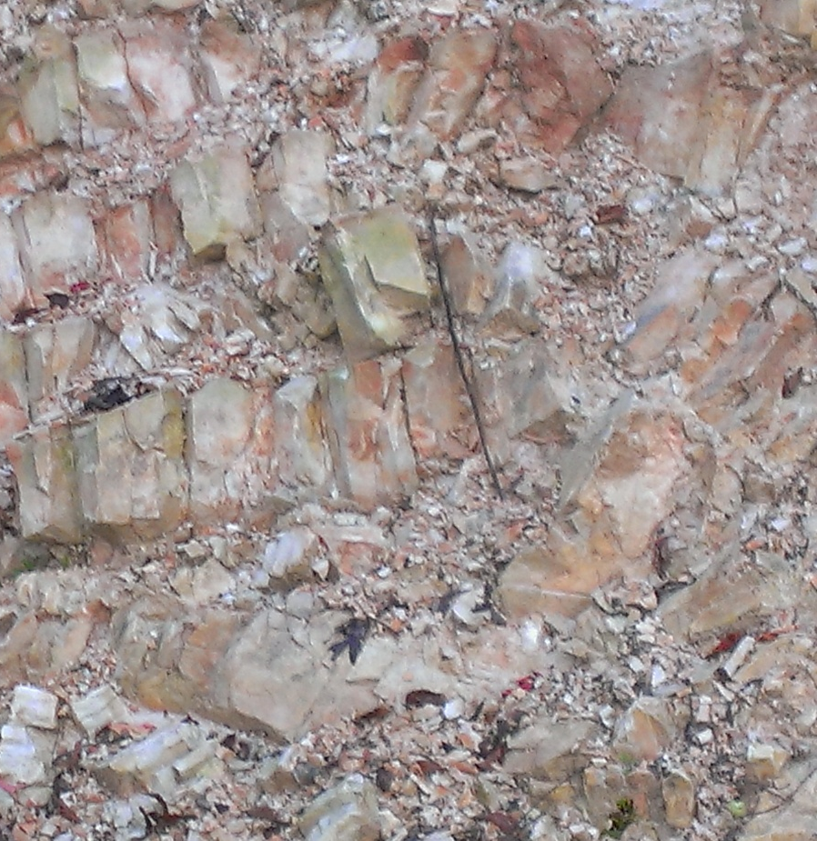
Typical Soil Profile
Alluvial
Deposits
Bedded
Chert
In-Situ Outcrop of Similar Material

Slide 7
2. Pier Foundation Design Considerations
72” Open-ended driven pipe piles selected as appropriate foundation
API RP 2A method for axial resistance analyses considers
“plugged” and “unplugged” conditions
Constrictor plates (i.e.“artificial” plugs) to allow required penetration but force the piles to plug to achieve end bearing
Drivability/Constructability also a key factor in these analyses
Many combinations of hammers, target depths considered

Slide 8
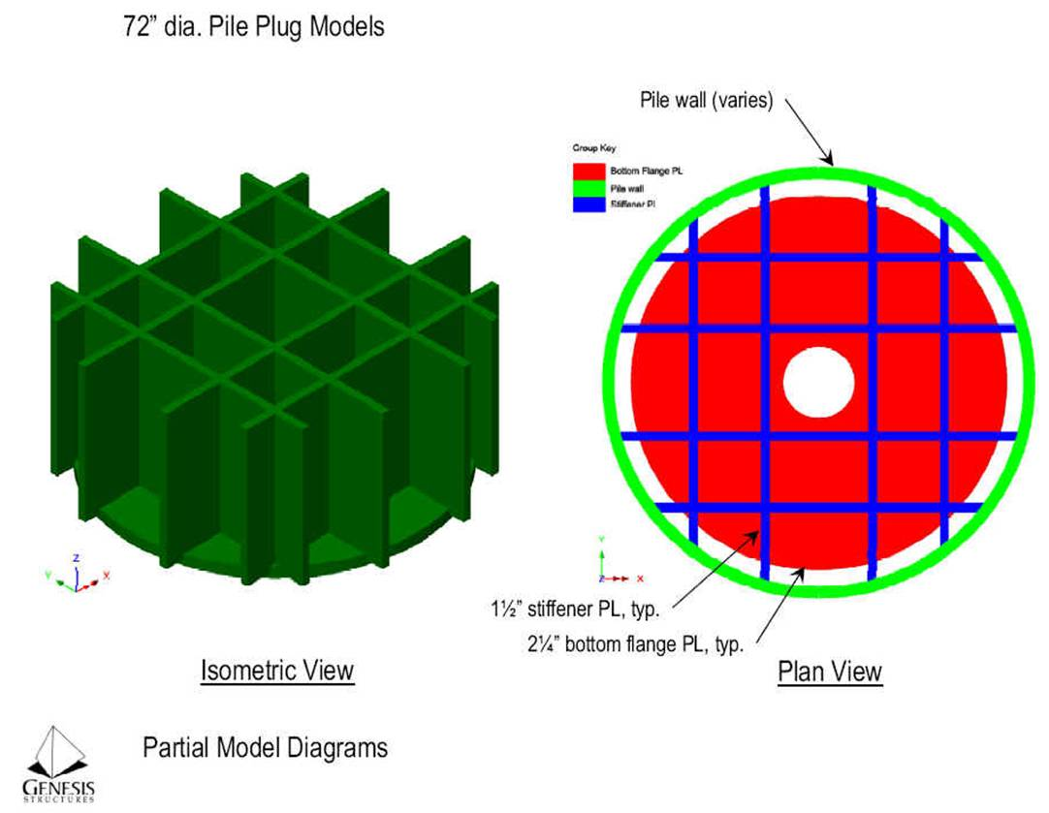
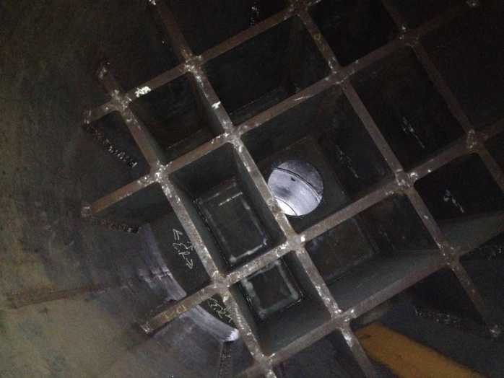
Constrictor Plate (i.e. Artificial Plug)
Placed ≈50 to 65 ft. above Pile Tips
Based on Depth to Bedded Chert
Artificial Plug Design Calculations by Genesis Structures, 2013

Slide 9
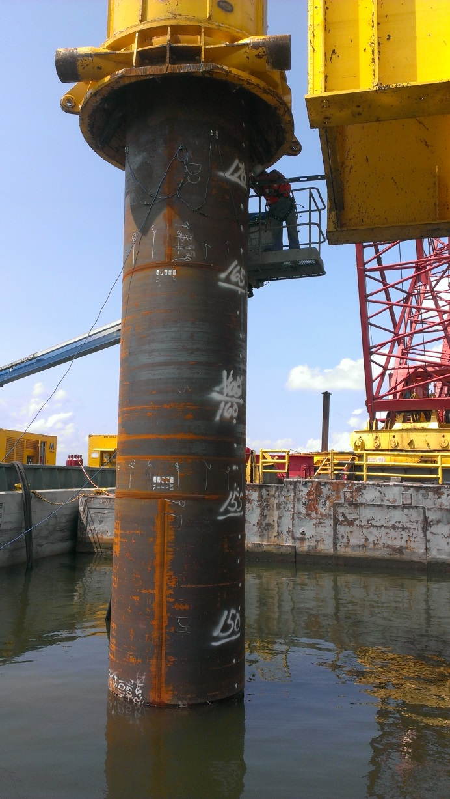
3. Load Test Program
Test Program
Dynamic Pile Testing (PDA)
Lateral (4 loads up to 425 kips ESL)
Axial Load Tests
Pile K-1 (48”) - 6000+ kip Static
Pile K-2 (48”) - 6950 kip Statnamic
Pile K-3 (72”) - 8500+ kip Statnamic
Confidence in K-3 – Linked to Static
Compared Production Pile Data to K-3
9

Slide 10
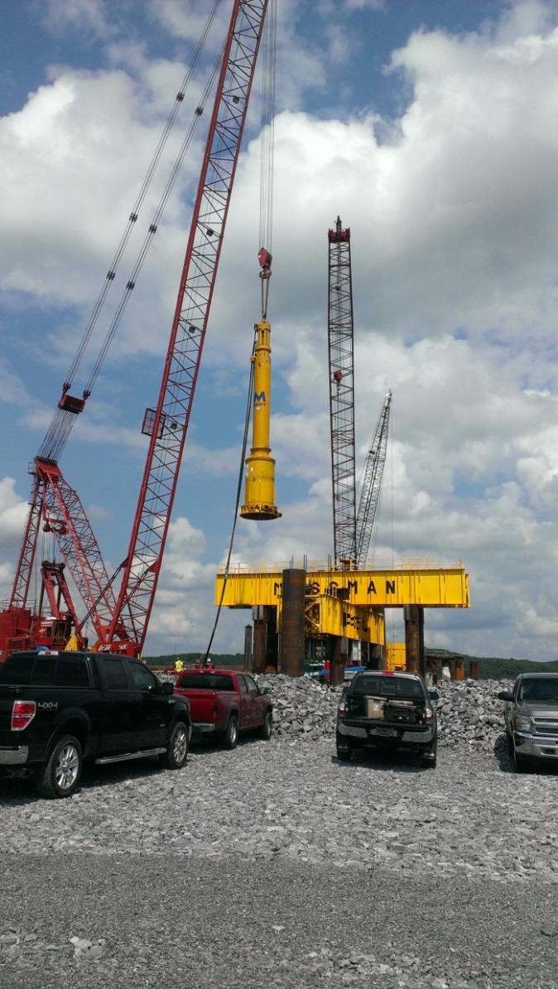
Load Test Program Results
Summary of Results
Menck MHU 800S Hammer used successfully
Constrictor Plate Functional for plugging
Nominal Resistance achieved Near Estimated Tip Elevations but deeper penetrations achievable
Resistance during pile driving less than long-term static resistance (~40% - 80%, typically ≈ 70%)
Recommendations developed for production pile verification test program
Dynamic Pile Testing required
Longer-term pile restrikes required
10

Slide 11
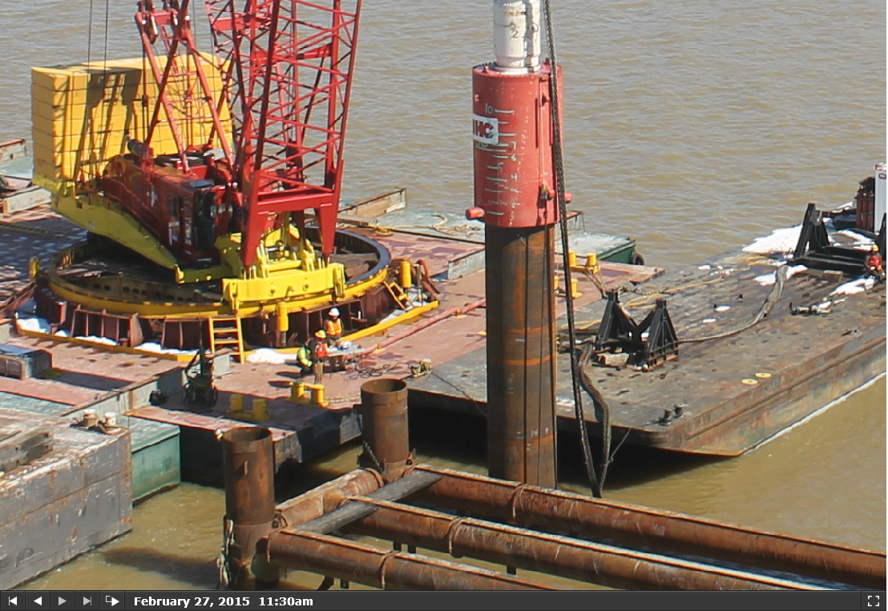
4. Installation Sequence
Driving test pile

Slide 13
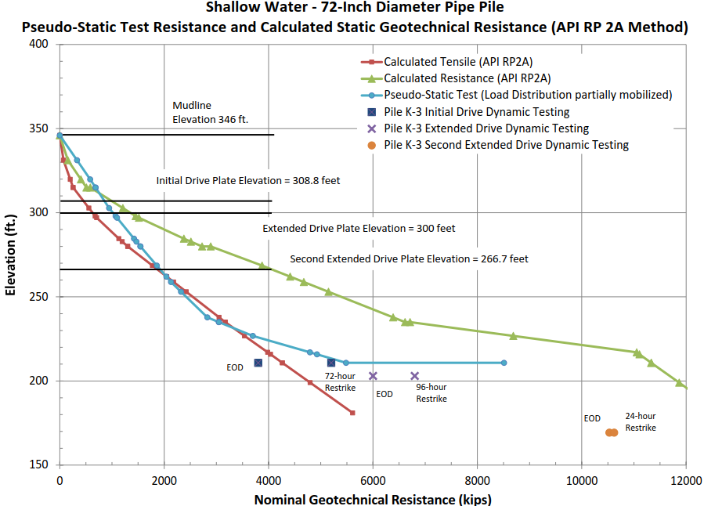
SETUP MAGNITUDE AND RATE
Pile K-3 - 72-inch-diameter Pipe Pile -
Pseudo-Static Test Resistance and Calculated Static Geotechnical Resistance (API RP 2A Method)

Slide 14
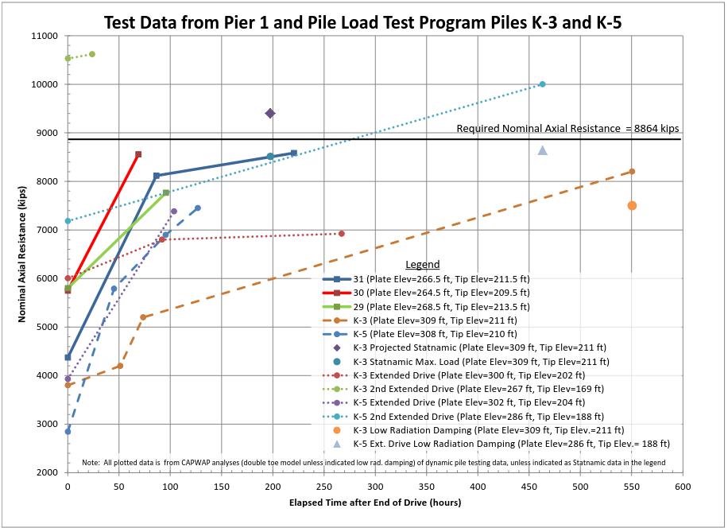
Setup Magnitude (72-inch-diameter Pipe Piles)

Slide 15
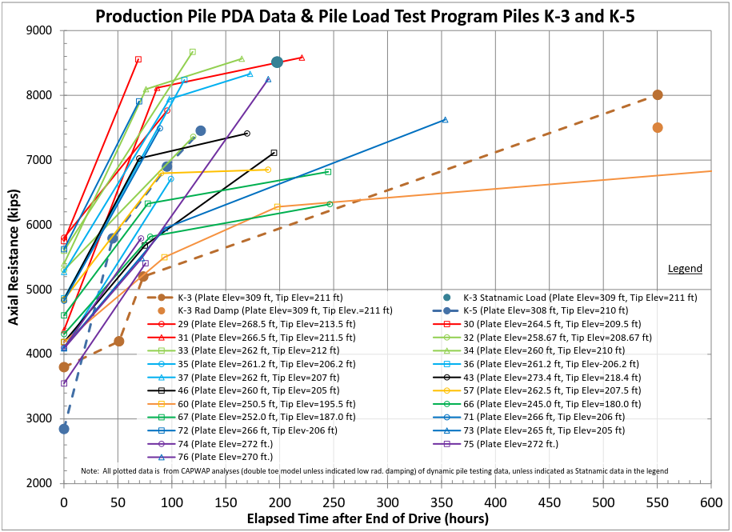
Setup Magnitude (72-inch-diameter Pipe Piles)

Slide 16
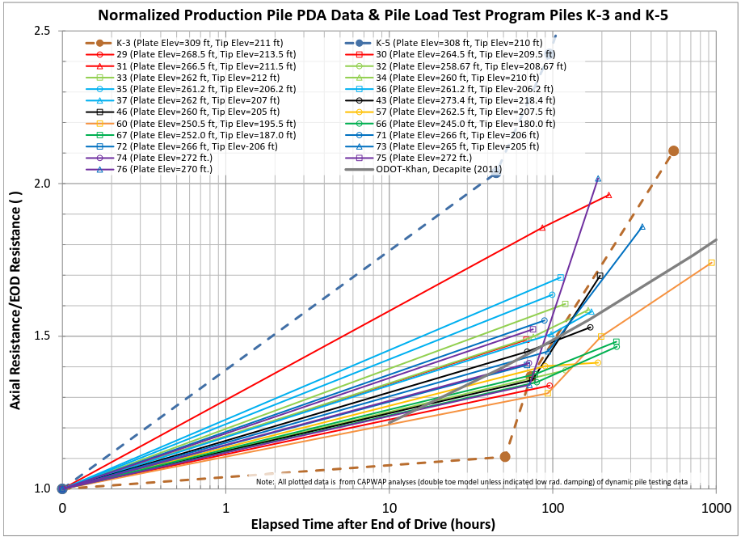
Setup Rate (72-inch-diameter Pipe Piles)

Slide 17
Setup Summary (72-inch-diameter Pipe Piles with Plates)
Statnamic Load Test Nominal Resistance: ~ 2.2 x EOD Resistance
Elapsed Time after End Of Drive (EOD) - Restrikes | Minimum PDA Resistance / EOD Value | Maximum PDA Resistance / EOD Value
72 | 1.2 | 1.8
96 | 1.3 | 1.9
168 | 1.5 | 2.2
500+ | 1.7 | 2.1

Slide 18
6. Constrictor Plate Considerations
Driven open-ended to minimum depth to develop lateral resistance
Insert (constrictor) plate positioned inside pile to develop soil plug/end bearing after minimum depth achieved
Excess Pore Pressure directly below constrictor plate – affects measured EOD PDA resistance
Soft soil – extrudes through center hole and annular gap into the grillage and above

Slide 19
Signal Matching Analyses
Constrictor Plate impacts the PDA response and signal matching analyses – two models considered
Double toe model – poor match quality, lower end bearing values
Low Radiation Damping – better match quality, higher end bearing values

Slide 20
7. Superposition Concept (for this site)
Dynamic Testing Superposition Concept at Restrike (using Signal Matching analysis such as CAPWAP):
Max Skin Resistance occurred at small vertical deformation.
Skin resistance decreases with every hammer blow until a “residual” value is achieved. Static skin resistance occurs at the first hammer blow (high energy blow)
Max end resistance requires more vertical movement at the pile toe. Later blow counts generally achieve the highest estimate of static end bearing estimate.
Maximum nominal resistance of the pile was typically not observed by any one hammer blow during the restrike(s).
Maximum Measured Resistance from Dynamic Testing using Superposition:
CAPWAP Side Resistance at Early Hammer Blow + CAPWAP End Resistance at Later Hammer Blow
Notes:
Dynamic Testing Superposition Concept at Restrike (using Signal Matching analysis such as CAPWAP)
Maximum Skin Resistance occurs at minimum vertical deformation.
Once pile begins to move vertically, skin resistance quickly decreases with every hammer blow until a “residual” value is achieved. The best estimate of the static skin resistance occurs at the first hammer blow during restrike, provided a high energy hammer blow occurs. This can be very difficult to achieve using diesel hammers, unless the hammer is warmed up.
Maximum end resistance requires vertical movement at the pile toe. Maximum end bearing resistance may never be achieved during a 4 or 5 blow restrike, but the later blow counts generally achieve the highest estimate of static end bearing estimate.
Unless the pile hammer has adequate energy to fully develop the side resistance and end resistance in one hammer blow, the maximum nominal resistance of the pile is never measured by any one hammer blow during the restrike.
Maximum Measured Resistance from Dynamic Testing using Superposition:
CAPWAP Side Resistance at Early Hammer Blow + CAPWAP End Resistance at Later Hammer Blow

Slide 21
Large-Diameter Pipe Pile
Installation at Kentucky Lake
Questions???
Darrin Beckett – KYTC
Ron Ebelhar – Terracon Consultants

